Slide 1
TEAM AMBITIOUS WAFFLES
Team members :
Tabish Khalid Halim
Niteesh Kamal Chaudhary
Shashank

Slide 2

trupen

Slide 3






Project details :
The main components used in our project are :
HTML
JavaScript
PHP
MySQL
Mercury
jQuery

Slide 4
Project details :
The main components used in our project are :
HTML
JavaScript
PHP
MySQL
Mercury
jQuery

Slide 5
Project details :
The main components used in our project are :
HTML
JavaScript
PHP
MySQL
Mercury
jQuery

Slide 6
Project details :
The main components used in our project are :
HTML
JavaScript
PHP
MySQL
Mercury
jQuery

Slide 7
Project details :
The main components used in our project are :
HTML
JavaScript
PHP
MySQL
Mercury
jQuery

Slide 8
Project details :
The main components used in our project are :
HTML
JavaScript
PHP
MySQL
Mercury
jQuery

Slide 9

Project details :
Along with these languages , we have also used Bootstrap CSS for additional styling .

Slide 10
Features :
Basic features:
Online timed MCQ quizzes with timer and auto-submit feature
Beautiful and easy to use UI
Password Recovery through OTP feature on G-mail
Quiz Analytics and Class performance (visible for teacher)
Overall self analysis for students.
Print Request feature
Online Messaging System

Slide 11
Features :
Additional Features :
A User-Support Chatbot made with JavaScript
Profile Updation through in-built UI
Notification Bell feature
Dark-mode UI

Slide 12
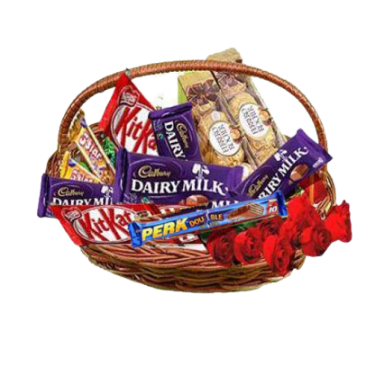
Thank You !

